Slide 1
Storing Data: Disks and Buffers

Slide 2
Big picture: Architecture of a DBMS

Slide 3
Architecture of a DBMS: SQL Client
Last few lectures: SQL
Next:
How is a SQL query executed?
SQL Client
Database Management
System
Database

Slide 4
DBMS: Parsing & Optimization
Purpose:
Parse, check, and verify the SQL
SELECT S.sid, S.sname, R.bid
FROM Sailors R, Reserves R
WHERE S.sid = R.sid and S.age > 30 GROUP BY age
And translate into an efficient
relational query plan
SQL Client
Database Management
System
Query Parsing & Optimization
Database

Slide 5
DBMS: Relational Operators
Purpose: Execute a dataflow by
operating on records and files
SQL Client
Database Management
System
Query Parsing & Optimization
Relational Operators
GroupBy (Age)
Indexed Join
Heap Scan Reserves
Indexed Scan Sailors
Database

Slide 6
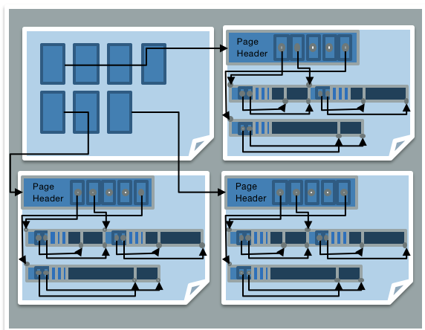
DBMS: Files and Index Management
Purpose: Organize tables and
Records as groups of pages in
a logical file
SQL Client
Database Management
System
SSN | Last Name | First Name | Age | Salary
123 | Adams | Elmo | 31 | $400
443 | Grouch | Oscar | 32 | $300
244 | Oz | Bert | 55 | $140
134 | Sanders | Ernie | 55 | $400
Query Parsing & Optimization
Relational Operators
Files and Index Management
Database

Slide 7
DBMS: Buffer Management
Purpose:
Provide the illusion of operating
in memory
SQL Client
Database Management
System
Query Parsing & Optimization
RAM
Relational Operators
Page 1
Page 2
Page 3
Files and Index Management
Buffer Management
Database
Disk Space Management

Slide 8
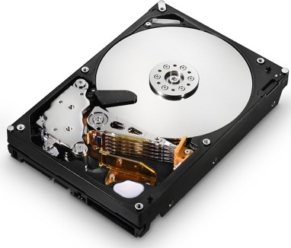
DBMS: Disk Space Management
Purpose: Translate page requests into physical bytes on one or more device(s)
SQL Client
Database Management
System
Query Parsing & Optimization
Relational Operators
Block 1
Block 2
Block 3
Files and Index Management
Buffer Management
Disk Space Management
Database

Slide 9
Architecture of a DBMS
Organized in layers
Each layer abstracts the layer below
Manage complexity
Performance assumptions
Example of good systems design
SQL Client
Database Management
System
Query Parsing & Optimization
Relational Operators
Files and Index Management
Buffer Management
Disk Space Management
Database

Slide 10
DBMS: Concurrency & Recovery
Two cross-cutting issues related to storage and memory management:
SQL Client
Database Management
System
Query Parsing & Optimization
Relational Operators
Concurrency Control
Files and Index Management
Recovery
Buffer Management
Disk Space Management
Database

Slide 11
Context
SQL Client
Completed
Database Management
System
Query Parsing & Optimization
Relational Operators
Files and Index Management
Buffer Management
You are Here
Disk Space Management
Database

Slide 12
Context, cont.
Completed
We’ll visit here
SQL Client
Database Management
System
Query Parsing & Optimization
Relational Operators
Files and Index Management
Buffer Management
You are Here
Disk Space Management
Database

Slide 13
Before We Begin: Storage Media

Slide 14
Disks
Most database systems were originally designed for magnetic disks
Disk are a mechanical anachronism!
Instilled design ideas that apply to using solid state disks as well
Major implications!
No “pointer derefs”. Instead, an API:
READ: transfer “page” of data from disk to RAM.
WRITE: transfer “page” of data from RAM to disk.
Both API calls are very, very slow!
Plan carefully!
An explicit API can be a good thing
Minimizes the kind of pointer errors you see in C

Slide 15
Economics
$1000 at NewEgg 2018:
Mag Disk: ~40TB for $1000
SSD: ~2.3TB for $1000
RAM: 80GB for $1000

Slide 16
Storage Hierarchy
Small, Fast
Registers
L1 Cache
L2 Cache
RAM
For currently used Data
Varies by deployment
Database and backup/logs Secondary & tertiary storage
Big, Slow
SSD
Disk

Slide 17
Hierarchy - Storage Latencies
Registers
L1 Cache
.5 ns – L1 cache reference
7.0 ns – L2 cache reference
100.0 ns – main memory reference
1,000,000.0 ns – to read 1MB sequentially
20,000,000.0 ns to read 1MB sequentially
L2 Cache
RAM
SSD
Disk

Slide 18
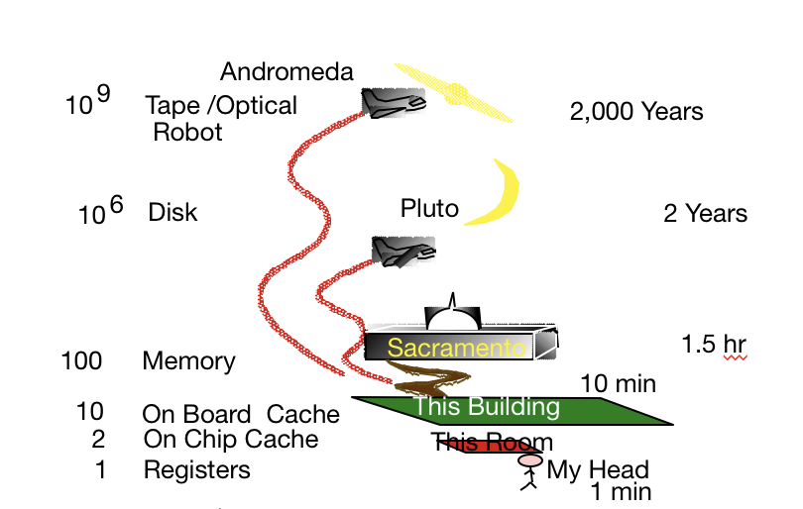
How Far Away is the Data?
Note: From Turing Award Winner Jim Gray

Slide 19
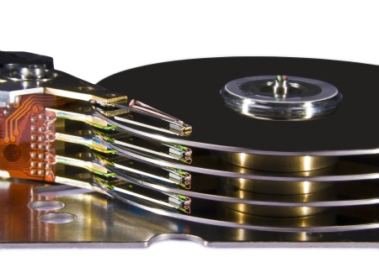
Components of a Disk, Pt. 1
Spindle
Disk head
Platters spin (say 15000 rpm)
Arm assembly moved in or out to position a head on a desired track
Tracks under heads make a “cylinder”
Platters
Tracks
Arm assembly
Disk Platters

Slide 20
Components of a Disk, Pt. 2
Spindle
Disk head
Platters spin (say 15000 rpm)
Arm assembly moved in or out to position a head on a desired track
Tracks under heads make a “cylinder”
Platters
Tracks
Arm assembly

Slide 21
Components of a Disk, Pt. 3
Spindle
Disk head
Platters spin (say 15000 rpm)
Arm assembly moved in or out to position a head on a desired track
Tracks under heads make a “cylinder”
Platters
Arm movement
Tracks
Arm assembly

Slide 22
Components of a Disk, Pt. 4
Spindle
Disk head
Platters spin (say 15000 rpm)
Arm assembly moved in or out to position a head on a desired track
Tracks under heads make a “cylinder”
Platters
Tracks
Arm assembly

Slide 23
Components of a Disk, Pt. 5
Spindle
Disk head
Platters spin (say 15000 rpm)
Arm assembly moved in or out to position a head on a desired track
Tracks under heads make a “cylinder”
Only one head reads/writes at any one time
Platters
Tracks
Arm assembly

Slide 24
Components of a Disk, Pt. 6
Spindle
Disk head
Platters spin (say 15000 rpm)
Arm assembly moved in or out to position a head on a desired track
Tracks under heads make a “cylinder”
Only one head reads/writes at any one time
Block/page size is a multiple of (fixed) sector size
Sector
Platters
Arm movement
Tracks
Arm assembly

Slide 25
Accessing a Disk page
Time to access (read/write) a disk block:
seek time (moving arms to position disk head on track)
~2-3 ms on average
rotational delay (waiting for block to rotate under head)
~0-4 ms (15000 RPM)
transfer time (actually moving data to/from disk surface)
~0.25 ms per 64KB page
Key to lower I/O cost: reduce seek/rotational delays

Slide 26
Content Break

Slide 27

Notes on Flash (SSD)
Issues in current generation (NAND)
Fine-grain reads (4-8K reads), coarse-grain writes (1-2 MB writes)
Only 2k-3k erasures before failure, so keep moving hot write units around (“wear leveling”)
Write amplification: big units, need to reorg for wear & garbage collection

Slide 28
Notes on Flash (SSD), Pt. 2
So… read is fast and predictable
Single read access time: 0.03 ms
4KB random reads: ~500MB/sec
Sequential reads: ~525MB/sec
64K: 0.48 ms

Slide 29
Notes on Flash (SSD), cont
But... write is not! Slower for random
Single write access time: 0.03 ms
4KB random writes: ~120 MB/sec
Sequential writes: ~480 MB/sec

Slide 30

Is Flash Faster than Disk?
Why of course it is…it’s called “flash”!
Can be 1-10x the bandwidth (bytes/sec) of ideal HDD #s
Note: Ideal HDD #s hard to achieve.
Expect 10-100x bandwidth for non-sequential read.
Image

Slide 31
Is Flash Faster Than Disk Pt 2.
Locality” matters for both
Reading/writing to “far away” blocks on disk requires slow seek/rotation delay
Writing 2 “far away” blocks on SSD can require writing multiple much larger units
High-end flash drives are getting much better at this
And don’t forget:
Disk offers about 10x the capacity per $

Slide 32
Storage Pragmatics & Trends
Many significant DBs are not big.
Size in GB

Slide 33


Storage Trends Pt. 2
But data sizes grow faster than Moore’s Law
“Big Data” is real
Boeing 787 generates ½ TB of data per flight
Walmart handles 1M transactions/hour,
maintains 2.5 PetaByte data warehouse
So…what is the role of disk, flash, RAM
The subject of some debate!
Airplane Cash Register

Slide 34
Bottom Line (last few years)
Very large DBs: relatively traditional
Disk still the best cost/MB by a lot
SSDs improve performance and performance variance
Smaller DB story is changing quickly
Entry cost for disk is not cheap, so flash wins at the low end
Many interesting databases fit in RAM

Slide 35
Bottom Line Pt. 2
Change brewing on the HW storage tech side
Mixed answers on the SW/usage side
Big Data: Can generate and archive data cheaply and easily
Small Data: Many rich data sets have (small) fixed size
People will continue to worry about magnetic disk for some time yet, typically at large scale

Slide 36
Content Break 2

Slide 37
Disk Space Management

Slide 38
Disks and Files
Recall, most DBMSs stores information on Disks and SSDs.
Disk are a mechanical anachronism (slow!)
SSDs faster, slow relative to memory, costly writes
Disk Platters

Slide 39
Block Level Storage
Read and Write large chunks of sequential bytes
Sequentially: “Next” disk block is fastest
Maximize usage of data per Read/Write
“Amortize” seek delays (HDDs) and writes (SSDs): if you’re going all the way to Pluto, pack the spaceship full!
Predict future behavior
Cache popular blocks
Pre-fetch likely-to-be-accessed blocks
Buffer writes to sequential blocks
More on these as we go

Slide 40
A Note on Terminology
Block = Unit of transfer for disk read/write
64KB – 128KB is a good number today
Book says 4KB
Page: a common synonym for “block”
In some texts, “page” = a block-sized chunk of RAM
We’ll treat “block” and “page” as synonyms

Slide 41
Arranging Blocks on Disk
Disk head
Spindle
‘Next’ block concept:
sequential blocks on same track, followed by
blocks on same cylinder, followed by
blocks on adjacent cylinder
Arrange file pages sequentially by ‘next’ on disk
minimize seek and rotational delay.
For a sequential scan, pre-fetch
several blocks at a time!
Read large consecutive blocks
Arm movement
Tracks
Arm assembly

Slide 42
Disk Space Management, cont
SQL Client
Database Management
System
Query Parsing & Optimization
Lowest layer of DBMS, manages space on disk
Purpose:
Map pages to locations on disk
Load pages from disk to memory
Save pages back to disk & ensuring writes
Higher levels call upon this layer to:
Read/write a page
Allocate/de-allocate logical pages
Relational Operators
Files and Index Management
Buffer Management
Disk Space Management
Database

Slide 43
Disk Space Management: Requesting Pages
Request for a sequence of pages best satisfied by pages stored sequentially on disk
Physical details hidden from higher levels of system
Higher levels may “safely” assume Next Page is fast, so they will simply expect sequential runs of pages to be quick to scan.

Slide 44
Disk Space Management: Implementation
Proposal 1: Talk to the storage device directly
Could be very fast if you knew the device well
What happens when devices change?

Slide 45
Disk Space Management: Implementation 2
Proposal 2: Run over filesystem (FS)
Allocate single large “contiguous” file on a nice empty disk, and assume sequential/nearby byte access are fast
Most FS optimize disk layout for sequential access
Gives us more or less what we want if we start with an empty disk
DBMS “file” may span multiple FS files on multiple disks/machines

Slide 46

Using Local Filesystem
Get Page 4
Get Page 5
Disk Space Management
Big File 1
Big File 2
Big File 3
Page 1
Page 3
Page 4
Page 2
Page 4
Page 5
Page 6
Page 7
Page 9
Page 5
Page 8
File System
File System
File System

Slide 47
Summary: Disk Space Management
Provide API to read and write pages to device
Pages: block level organization of bytes on disk
Provides “next” locality and abstracts FS/device details
Disk Space Management
Page 1
Page 2
Page 3
Page 4
Page 5
Page 6

Slide 48
Content Break 3

Slide 49
Disks and Files: Summary
Magnetic (hard) disks and SSDs
Basic HDD mechanics
SSD write amplification
Concept of “near” pages and how it relates to cost of access
Relative cost of
Random vs. sequential disk access (10x)
Disk (pluto) vs RAM (sacramento) vs. registers (your head)
Big, big differences!

Slide 50
Files: Summary Pt 2
DB File storage
Typically over FS file(s)
Disk space manager loads and stores pages
Block level reasoning
Abstracts device and file system; provides fast “next”

